Slide 1
How does a model learn?
Forward and backpropagation!

Slide 2
Forward Propagation

Slide 3
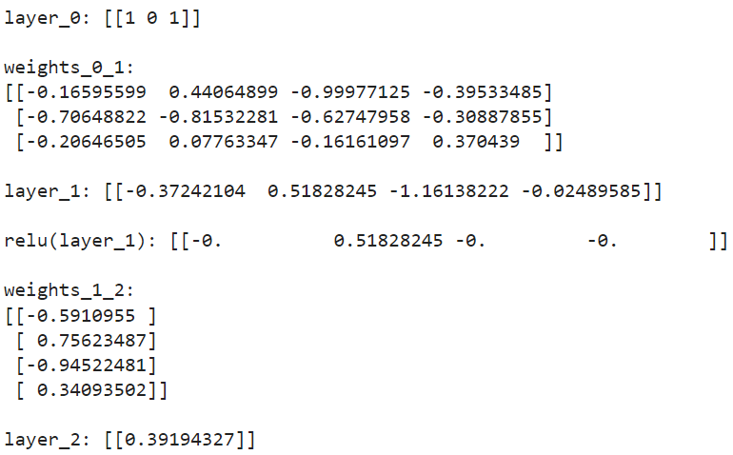
You should be able to do all of this forward propagation math by hand and draw a diagram

Slide 4
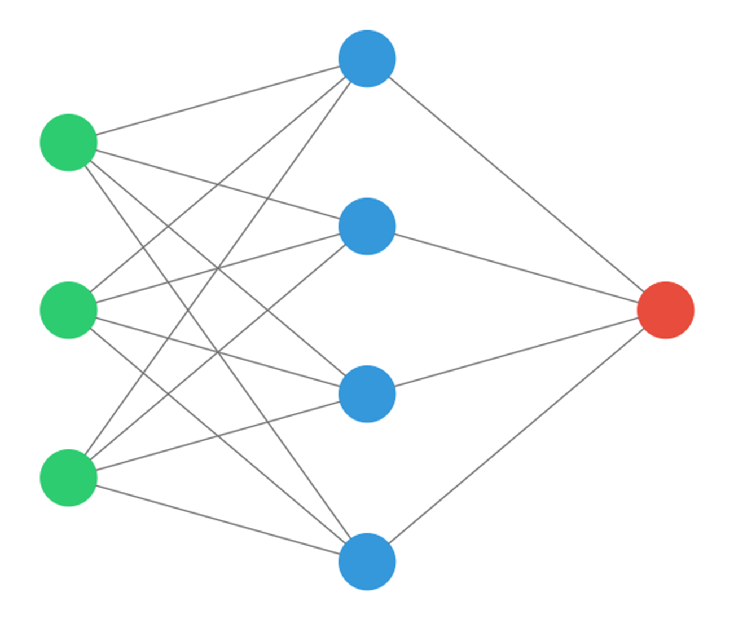
Draw an empty graph
Layer 2
Layer 0
Layer 1

Slide 5
Label the input layer
1
0
1

Slide 6
Add the weights
-0.372
-0.165
-0.706
1
-0.206
0
1
…compute the dot product

Slide 7
Add the weights
-0.372
1
0.44
-0.81
0.518
0.07
0
1
…compute the dot product

Slide 8
Add the weights
-0.372
1
0.518
0
-0.99
-0.62
-0.16
-0.161
1
…compute the dot product

Slide 9
Add the weights
-0.372
1
0.518
0
-0.161
-0.30
1
-0.39
0.37
-0.024
…compute the dot product

Slide 10
ReLu
-0.372
1
0.518
0
-0.161
1
-0.024
…before…

Slide 11
ReLu
0
1
0.518
0
0
1
0
Negative numbers recoded to 0, positive numbers remain as-is.
…after!

Slide 12
From Layer1 to Layer2
0
1
-0.59
0.518
0.75
0
0.39
-0.94
0
0.34
1
0
0.39 is the predicted value
… but 0 was our target variable!

Slide 13
Backpropagation
Let’s update the weights so that they make a more accurate prediction!

Slide 14
Calculate Squared Error and layer_2_delta
0
1
-0.59
0.518
0.75
0
0.39
-0.94
0
0.34
error = (layer_2-target_var)**2
1
layer_2_delta=(layer_2-target_var)
Squared Error: [[0.15361952]]
layer_2_delta: [[0.39194327]]
0
Use prediction error as a feedback signal! You just overestimated – update the weights so that the prediction is more accurate!

Slide 15
Calculate weight_delta_1_2 (think of direction and amount)
0
weight_delta_1_2 = layer_1.T.dot(layer_2_delta)
1
-0.59 -
0.518
0.75
weight_delta_1_2:
[[0. ]
[0.20313732]
[0. ]
[0. ]]
0
0.39
-0.94
0
0.34
1
0
Only weights that contributed to the prediction should be updated! Dot product between layer_1 and layer_2_delta tell us this.

Slide 16
Update weights_1_2!
0
weight_delta_1_2 = layer_1.T.dot(layer_2_delta)
1
-0.59 -
weight_delta_1_2:
[[0. ]
[0.20313732]
[0. ]
[0. ]]
0.518
0.75 – 0.1*0.203 = 0.73
0
0.39
-0.94
0
weights_1_2 -= alpha * weight_delta_1_2
0.34
new weights_1_2:
[[-0.5910955 ]
[ 0.73592114]
[-0.94522481]
[ 0.34093502]]
1
0
Since only the second unit in Layer 1 contributed any information… this is the only weight to get updated! The others don’t update.

Slide 17
Calculate layer_1_delta
layer_1_delta=layer_2_delta.dot(weights_1_2.T)
layer_1_delta *= relu2deriv(layer_1)
0
layer_1_delta: [[-0.231, 0.2884, -0.3704, 0.1336]] relu2deriv(layer_1_delta): [[0, 0.2884, 0, 0 ]]
1
-0.59
0.44
0.518
-0.81
0.73
0.07
0
0.39
-0.94
0
0.34
1
0
Only weights that contributed to the prediction should be updated! This says only weights touching second node get updated.

Slide 18
Calculate new weights_0_1
weight_delta_0_1 = layer_0.T.dot(layer_1_delta)
weights_0_1 -= alpha * weight_delta_0_1
0
weight_delta_0_1:
[[0. 0.28843 0. 0. ]
[0. 0. 0. 0. ]
[0. 0.28843 0. 0. ]]
new weights_0_1:
[[-0.16595 0.411805 -0.99977125 -0.39533485]
[-0.706488 -0.815322 -0.62747958 -0.30887855]
[-0.206465 0.048789 -0.16161097 0.370439 ]]
1
-0.59
0.44 – 0.1*0.288 = 0.411
0.518
-0.81
0.73
0
0.39
0.07 - – 0.1*0.288 = 0.0487
-0.94
0
0.34
1
0
The weights that helped contribute information got smaller! No info contributed? NO WEIGHT UPDATE!

Slide 19
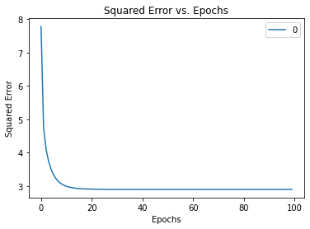
Done!
You just updated the weights to make a more accurate prediction! Only weights that contributed information got updated.
Repeat this methodology for each row in the dataset.
Repeat until the model converges and loss plateaus!

